Slide 1
Destination Plugins
Remeeza
23/06/2021

Slide 2
Contents
INTRODUCTION
FTP
SFTP
EMAIL SETTINGS
SFTP
GOOGLE DRIVE
DROP BOX
ONE DRIVE
SHARE POINT
BOX
EVERNOTE

Slide 3
What is plugin?
A plugin is a piece of software that we add to an existing computer program.
also called Add on or extension.
Add a specific feature to existing program.
Plugins can make your software either more powerful or better targeted to your specific requirement.
In our software we used plugins to send the scanned documents to the cloud destinations.

Slide 4
FTP
The File Transfer Protocol (FTP) is a standard communication protocol used for the transfer of computer files from a server to a client on a computer network.
User can upload scanned image to FTP server by setting Host name , Remote folder path , User name and password

Slide 5
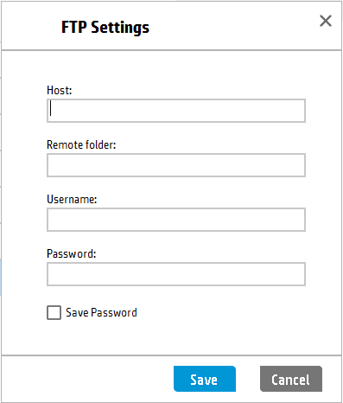
FTP

Slide 6
SFTP
Secure File Transfer Protocol (SFTP) is a file protocol for transferring large files over the web. It builds on the File Transfer Protocol (FTP) and includes Secure Shell (SSH)security components.
Secure Shell is a cryptographic component of internet security.
User can upload scanned image to SFTP server by setting Host name , Remote folder path , User name and password.

Slide 7
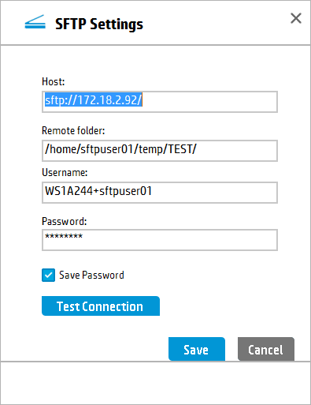
SFTP

Slide 8
E-mail settings
Two different styles of email are supported. Early versions of HP Scan support only MAPI email which sends the file through Outlook for distribution. In these versions, the Send To selection is “Email”.
Later versions of HP Scan also provide SMTP based email. Allowing the email settings to be provided from within HP Scan.

Slide 9
Email - SMTP
The Simple Mail Transfer Protocol (SMTP) is an internet standard communication protocol for electronic mail transmission.
The destination specific area contains those settings that a user may want to change on a per-scan basis.
The maximum file size that can be uploaded is restricted to 10MB.

Slide 10
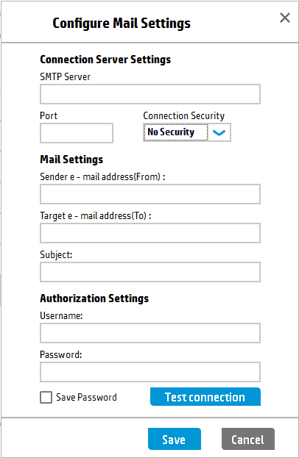
SMTP

Slide 11
Google Drive
HP Scan allows a user to scan directly to their Google Drive account.
It requires that a user already have the Google account created.
From HP Scan the user must be authenticated and login/Sign In to their Google Drive account. This can be setup before scanning by pressing the Configuration button.
If a user does not perform this step with the configuration button they will be prompted for login and authentication when they the scan is sent.

Slide 12
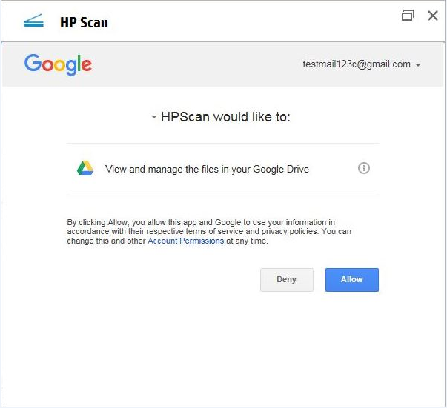
Google Drive

Slide 13
Drop Box
HPScan allows a user to scan directly to their Drop Box account.
Functionality is identical to Google Drive except that the format of the authentication and login dialogs are related to Drop Box rather than Google Drive

Slide 14
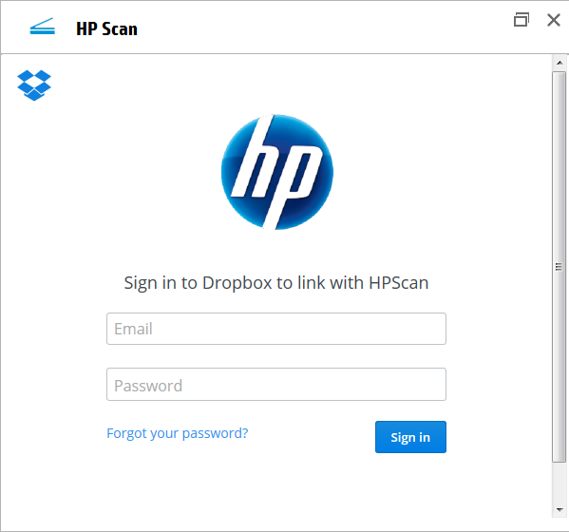
Drop Box

Slide 15
OneDrive
HP Scan allows a user to scan directly to their OneDrive account.
It requires that a user already have the Microsoft account created.
Functionality is identical to Drop Box except that the format of the authentication.

Slide 16
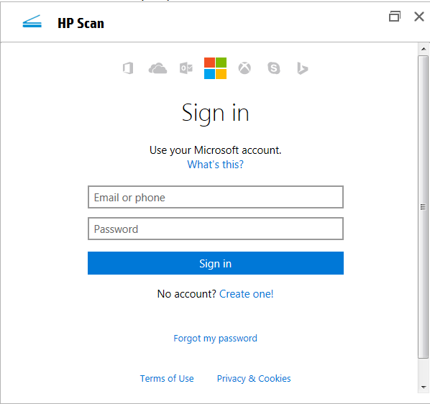
OneDrive

Slide 17
SharePoint
HP Scan allows a user to scan directly to their SharePoint .
Only HTTP protocol is supported
.

Slide 18
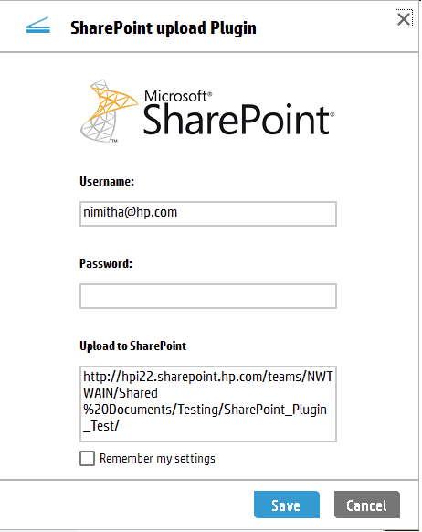
SharePoint

Slide 19
BOX
This plugin provides a read/write connector to interact with files on Box.com.
Box is a single, secure, easy-to-use platform built for the entire content lifecycle, from file creation and sharing, to co-editing, signature, classification, and retention.

Slide 20
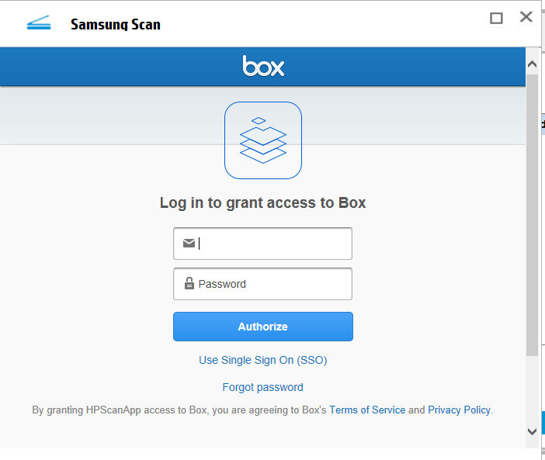
BOX

Slide 21
Ever Note
Evernote Web Clipper is a simple extension for your web browser that lets you capture full-page articles, images, selected text, important emails, and any web page that inspires you.
Save everything to Evernote and keep it forever.

Slide 22
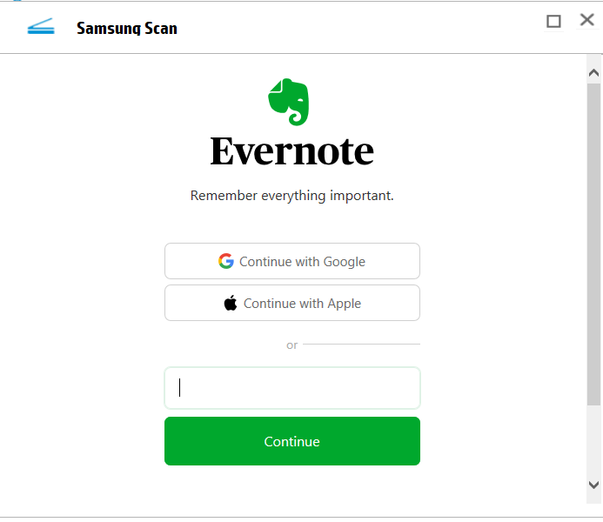
Ever Note

Slide 23


